Slide 1
Computer Graphics Environment Background
László Szécsi szecsi@iit.bme.hu
AIT

Slide 2
Compute ray direction
ray from eye through pixel in world space, which is, normalized, the
vector from eye to pixel, which is, interpolated, the
vector from eye to vertex of full-viewport quad, which can be computed using a matrix

Slide 3

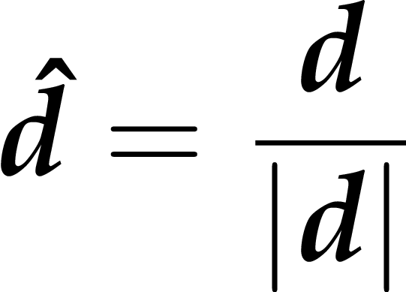

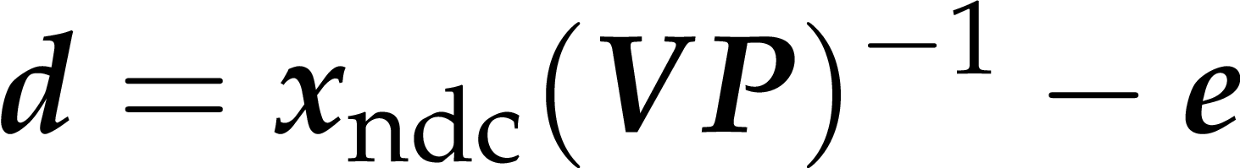
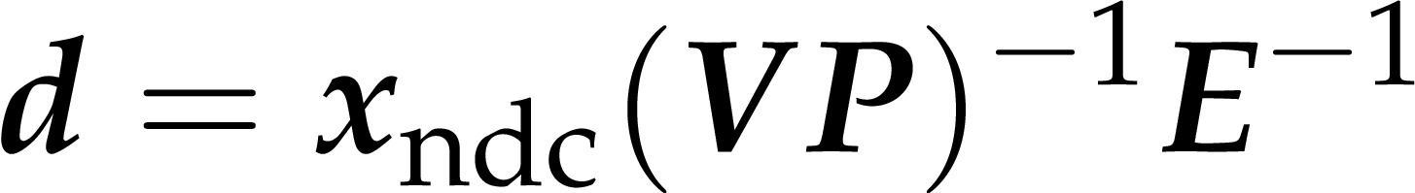
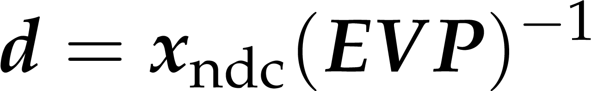
Ray direction from normalized device coords
(EVP)⁻¹ is henceforth called rayDirMatrix
a property of PerspectiveCamera
PerspectiveCamera#update must compute it
the reflection automatism will copy it to uniform camera.rayDirMatrix

Slide 4
Display environment as a background
.
draw full viewport quad (hurray!)
new VS: computes ray direction
must take matrix that computes world-space-coords-minus-eye-position from ndc (a.k.a. camera.rayDirMatrix)
camera must compute this matrix in PerspectiveCamera#update
does no transformation (being a full viewport quad)
z=0.99999, behind everything
FS gets ray direction from VS
addresses cube texture
returns color from texture

Slide 5
Cube texture
.
need a uniform in FS
in Scene create TextureCube, pass it to the FS through its Material, with a GameObject using the material (geometry is textured quad)
// need a sample uniform
uniform struct { samplerCube envTexture; } material;
// read from ray direction
fragmentColor = texture ( material.envTexture, rayDir.xyz);
this.envTexture = new TextureCube(gl, [
"media/posx512.jpg",
"media/negx512.jpg",
"media/posy512.jpg",
"media/negy512.jpg",
"media/posz512.jpg",
"media/negz512.jpg",]
);
this.backgroundMaterial.envTexture.set(this.envTexture);

Slide 6
TextureCube.js – loading images
.
"use strict";
/* exports TextureCube */
class TextureCube {
constructor(gl, mediaFileUrls) {
gl.pendingResources[mediaFileUrls[0]] = ++gl.pendingResources[mediaFileUrls[0]] || 1;
this.mediaFileUrls = mediaFileUrls;
this.glTexture = gl.createTexture();
this.loadedCount = 0;
this.images = [];
for(let i=0; i<6; i++){
this.images[i] = new Image();
this.images[i].onload = () => {
this.loaded(gl); }
this.images[i].src = mediaFileUrls[i];
}
}

Slide 7
TextureCube.js – resource creation
.
loaded(gl){
this.loadedCount++;
if(this.loadedCount < 6) {
return;
}
gl.bindTexture(gl.TEXTURE_CUBE_MAP, this.glTexture);
for(let i=0; i<6; i++){
gl.texImage2D(gl.TEXTURE_CUBE_MAP_POSITIVE_X+i, 0,
gl.RGBA, gl.RGBA, gl.UNSIGNED_BYTE, this.images[i]);
}
gl.texParameteri(gl.TEXTURE_CUBE_MAP, gl.TEXTURE_MAG_FILTER, gl.LINEAR);
gl.texParameteri(gl.TEXTURE_CUBE_MAP, gl.TEXTURE_MIN_FILTER, gl.LINEAR_MIPMAP_LINEAR);
gl.generateMipmap(gl.TEXTURE_CUBE_MAP);
gl.bindTexture(gl.TEXTURE_CUBE_MAP, null);
if( --gl.pendingResources[this.mediaFileUrls[0]] === 0 ) {
delete gl.pendingResources[this.mediaFileUrls[0]];
}
}
}

Slide 8
Do not forget to
!
include new shaders in index.HTML
create required Shader, TexturedProgram, Material objects
set the cube texture to the backgound material
create a TexturedQuadGeometry
create Mesh using the above material and geometry
create a GameObject using the above mesh

